Slide 1
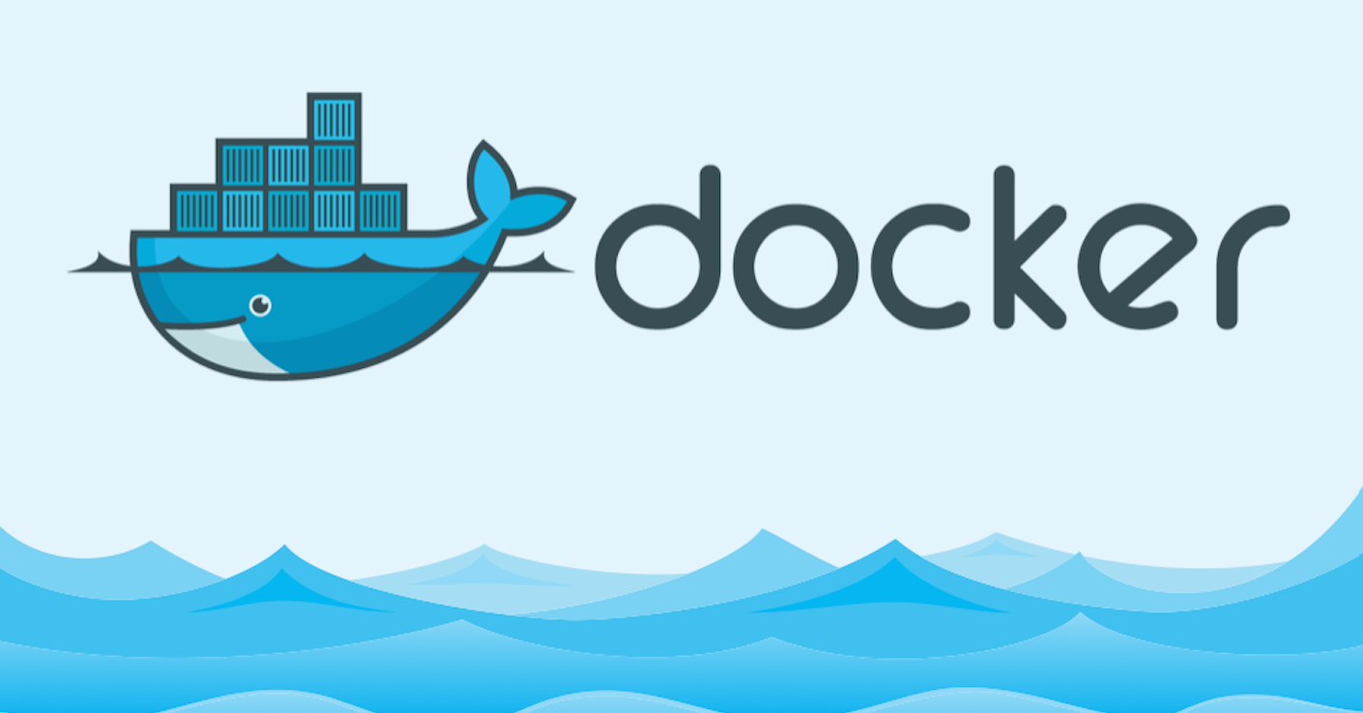
Docker Fundamentials
The open platform to build, ship and run any application anywhere

Slide 2
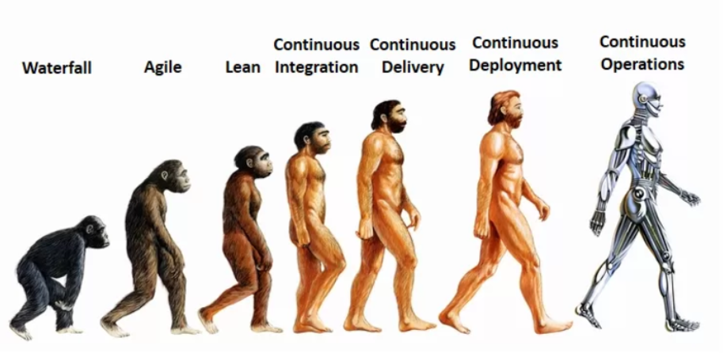
About me
14+ Engineering experience (Cisco Systems, VMware )
Continuous Operations freak and AWS enthusiast

Slide 3
Session Logistics
3 hours (exercising time included)
“Introduction to Docker” course required
You will need:
Linux machine
Dedicated
VM
Cloud provided
Enthusiasm
Registration at hub.docker.com

Slide 4
Recap from “Introductions to Docker”
Intro to Docker
Benefits of Container based virtualization
Docker concepts and terms
Simple container examples
Commands
docker run
docker ps
docker images
Open Question
Windows image
Freebsd image

Slide 5
Agenda
Building Images
Dockerfile
Managing Images and Containers
Pushing Images on Docker Hub
Docker Volumes
Basic Container networking
Configuring our first app

Slide 6
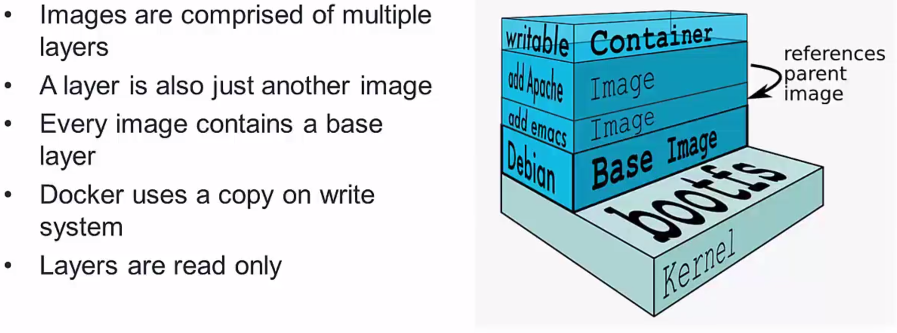
Image Layers

Slide 7
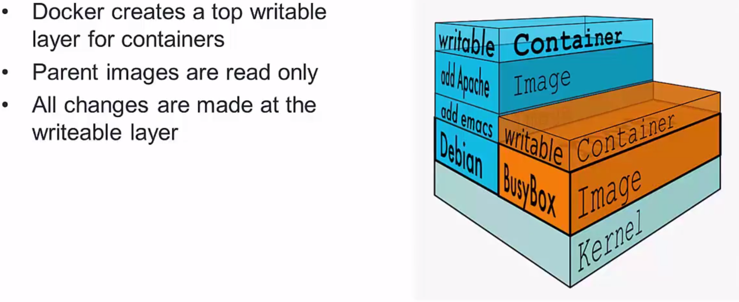
The Container Writable Layers

Slide 8
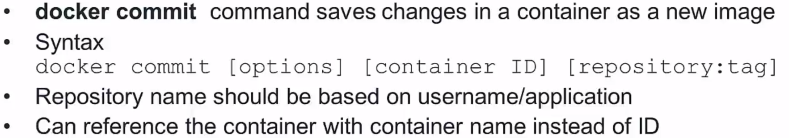
Docker Commit

Slide 9
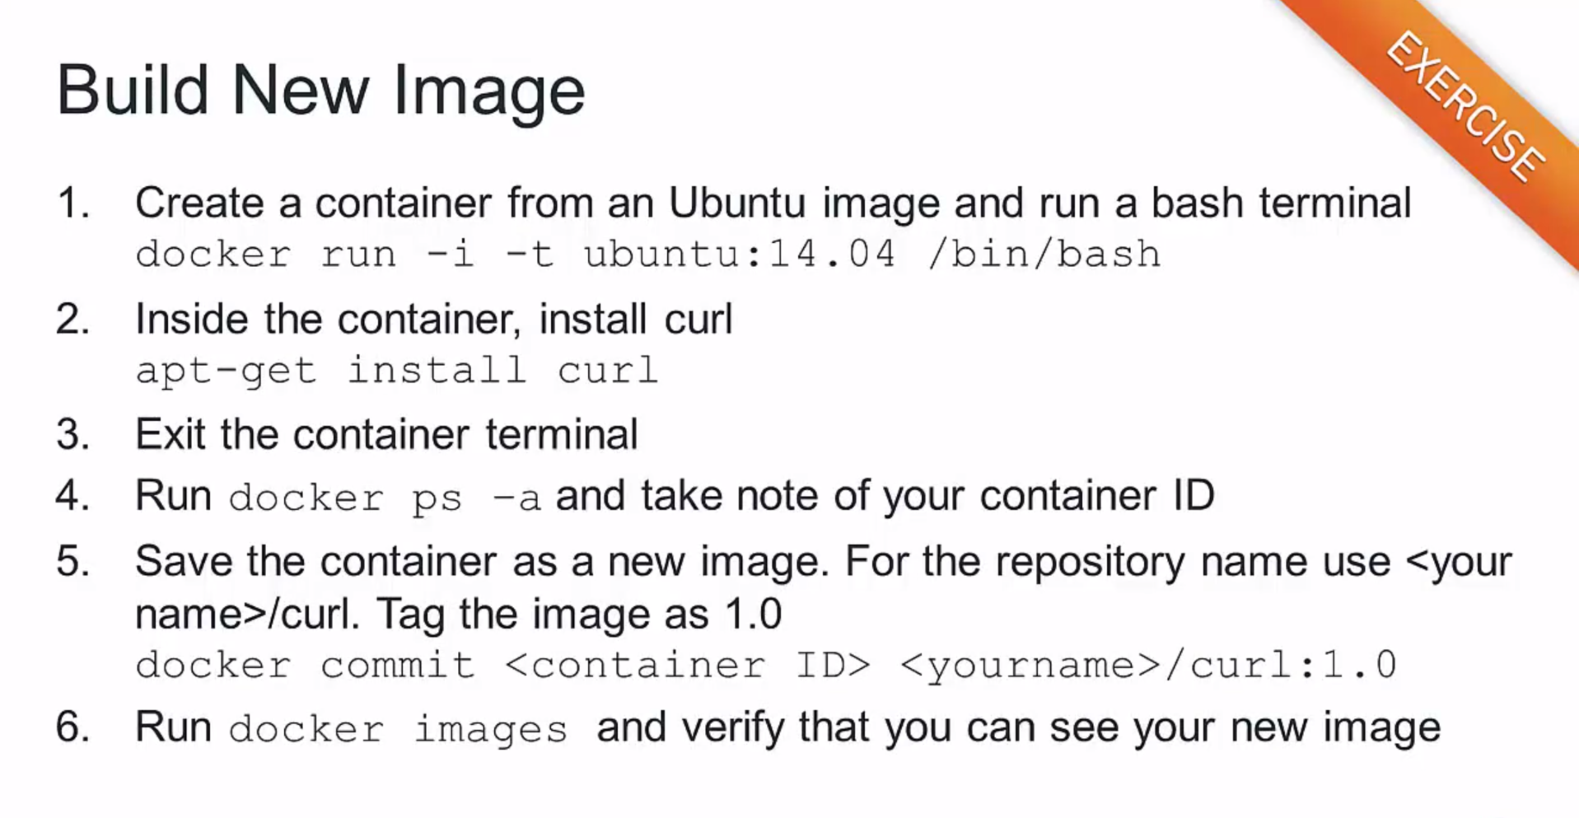

Slide 10
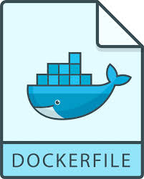
Dockerfile

Slide 11
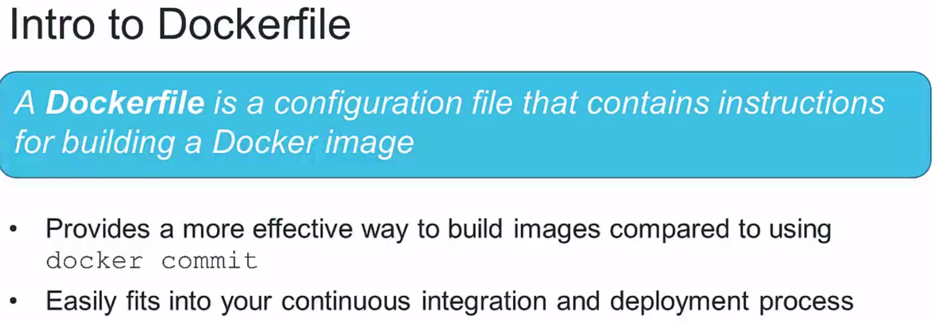

Slide 12
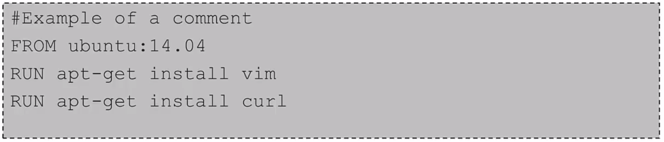
Dockerfile Instructions
Instructions specify what to do when build the image
FROM instruction specified what the base image should be
RUN instruction specified a command to execute

Slide 13
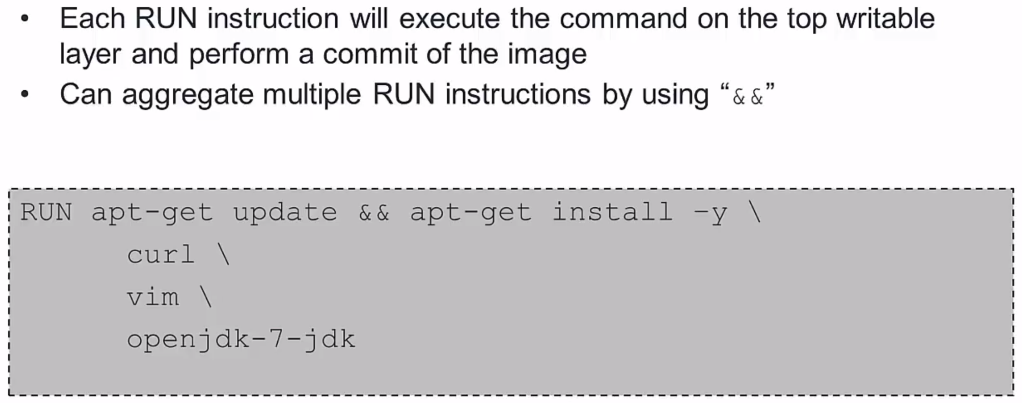
Run Instructions

Slide 14
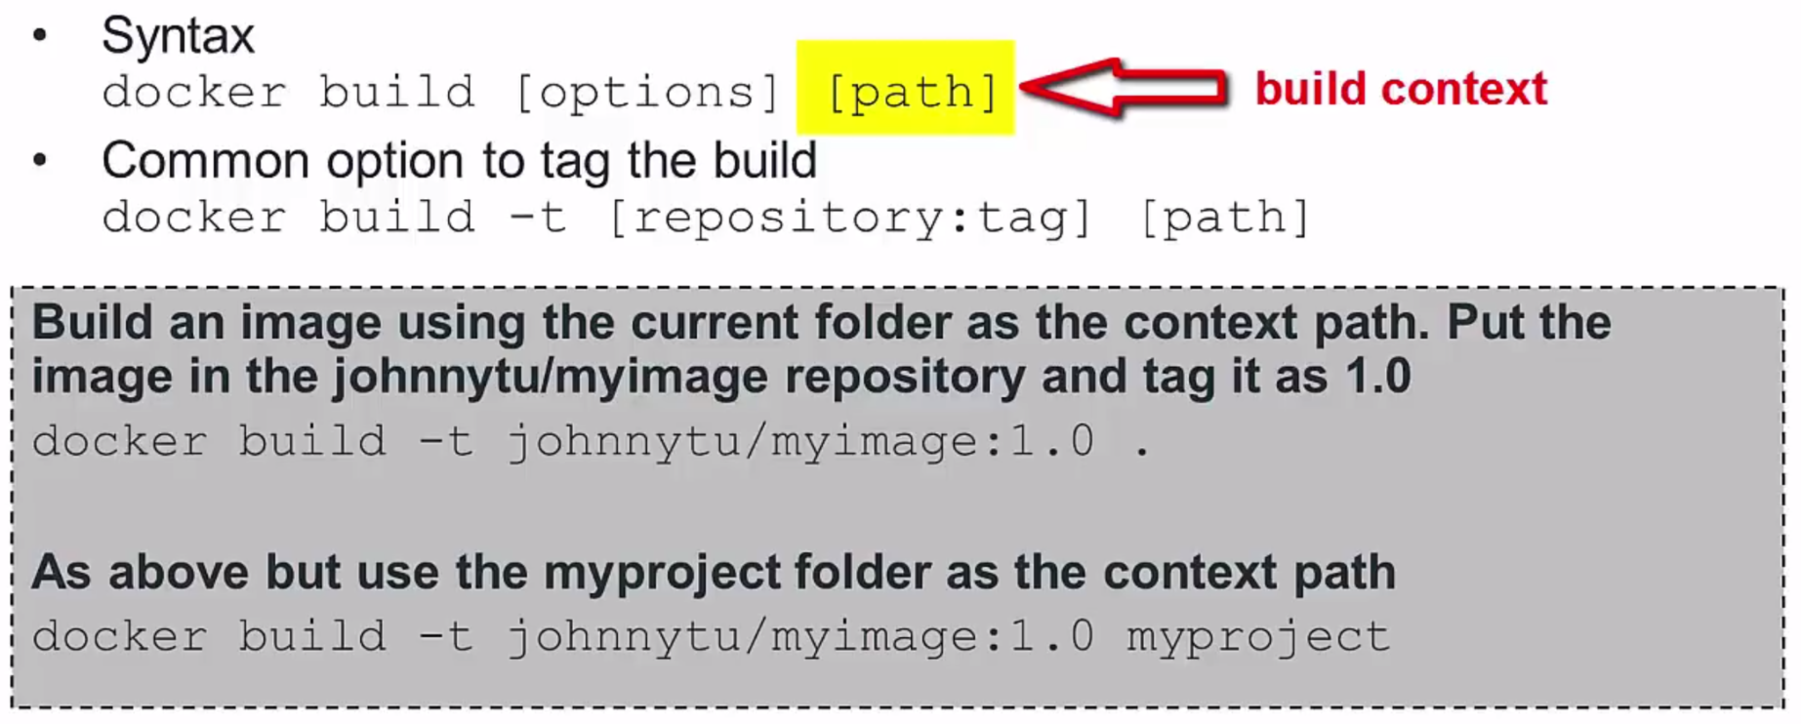
Docker Build

Slide 15

Build from Dockerfile
Build your own image and verify the curl is inside the container

Slide 16
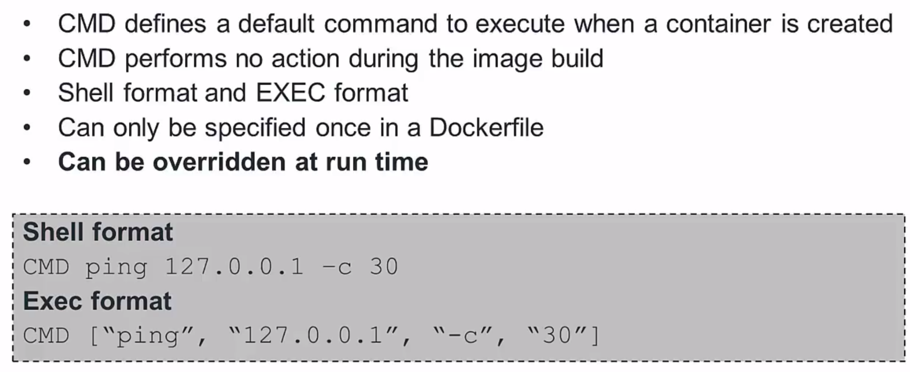
CMD Instructions

Slide 17
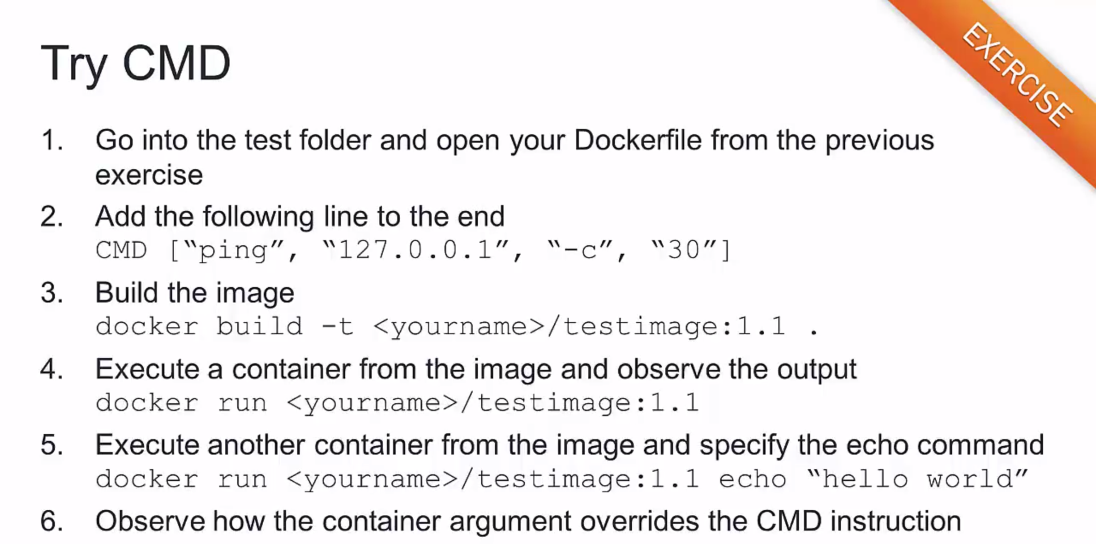

Slide 18
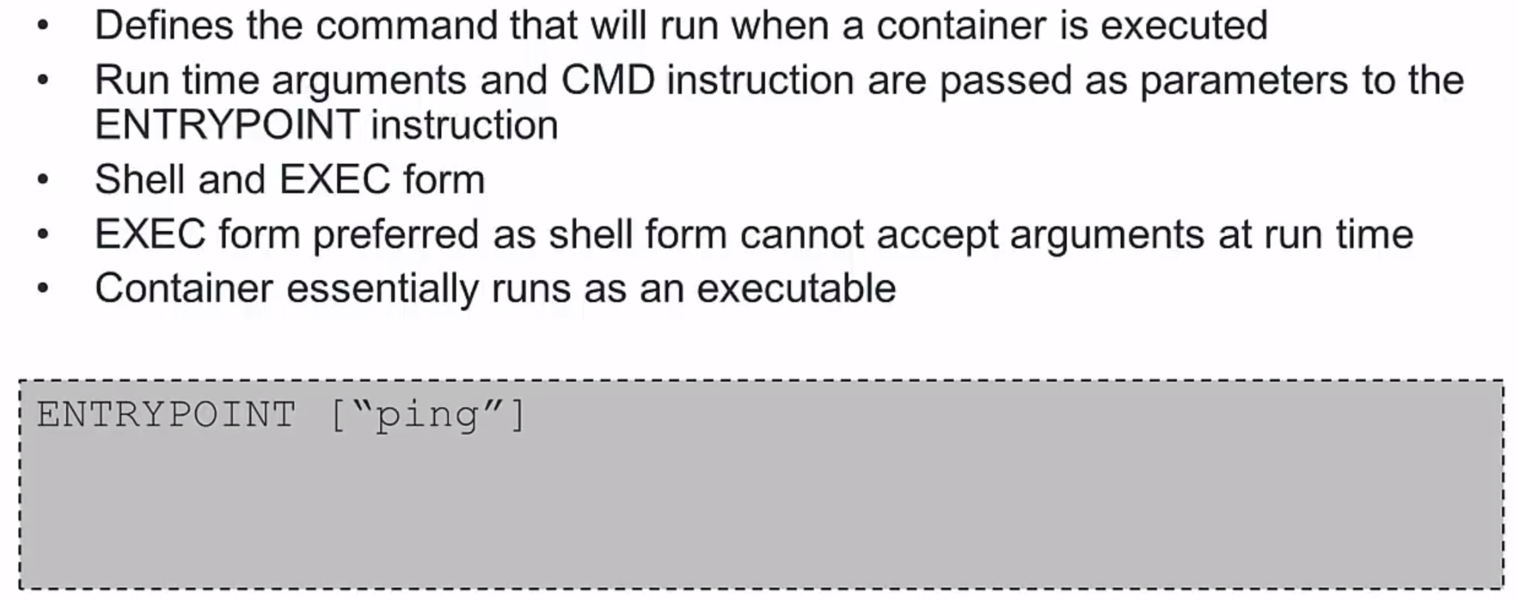
ENTRYPOINT Instruction

Slide 19
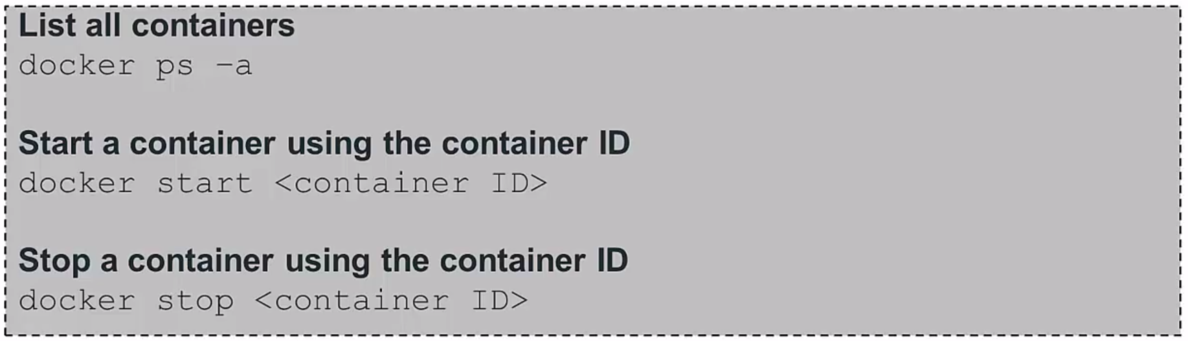
Start and Stop Containers

Slide 20
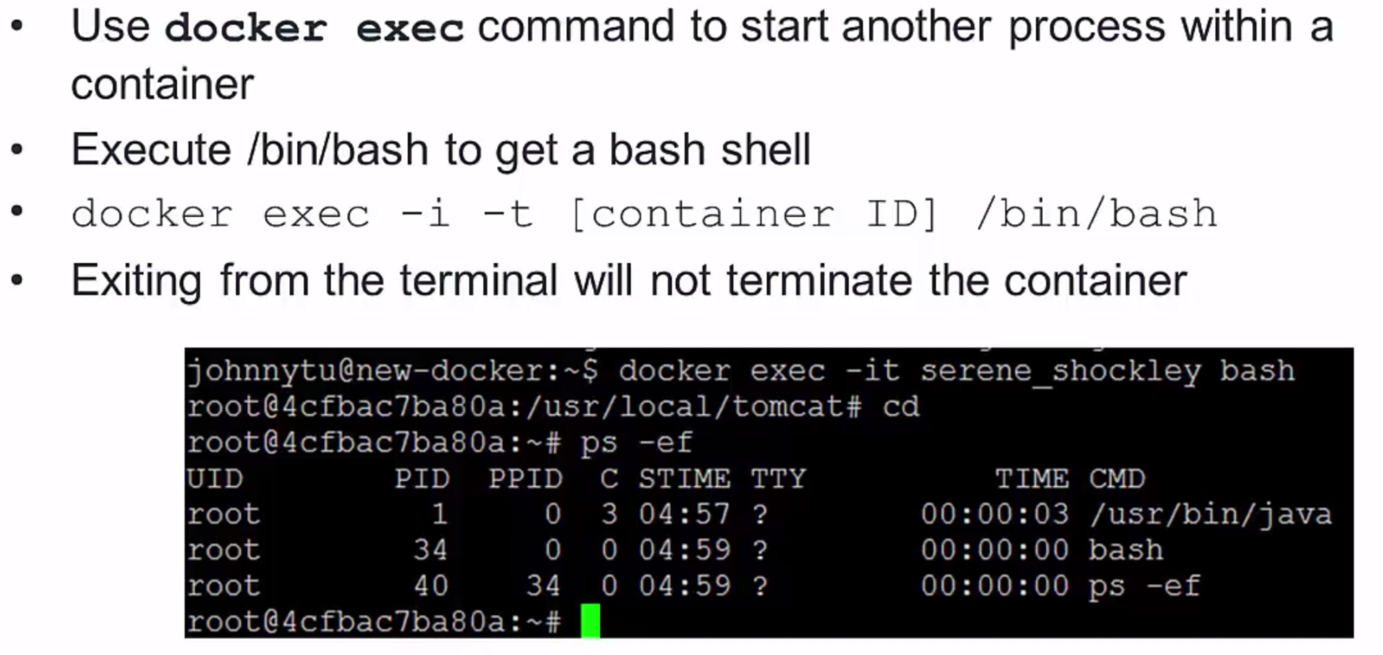
Getting terminal access

Slide 21
Clean-up
Containers
docker rm
docker rm $(docker ps -a –q)
Images
docker rmi
docker rmi $(docker images -q --filter "dangling=true")
Volumes
docker volumes rm
docker volume rm $(docker volume ls -qf dangling=true)

Slide 22
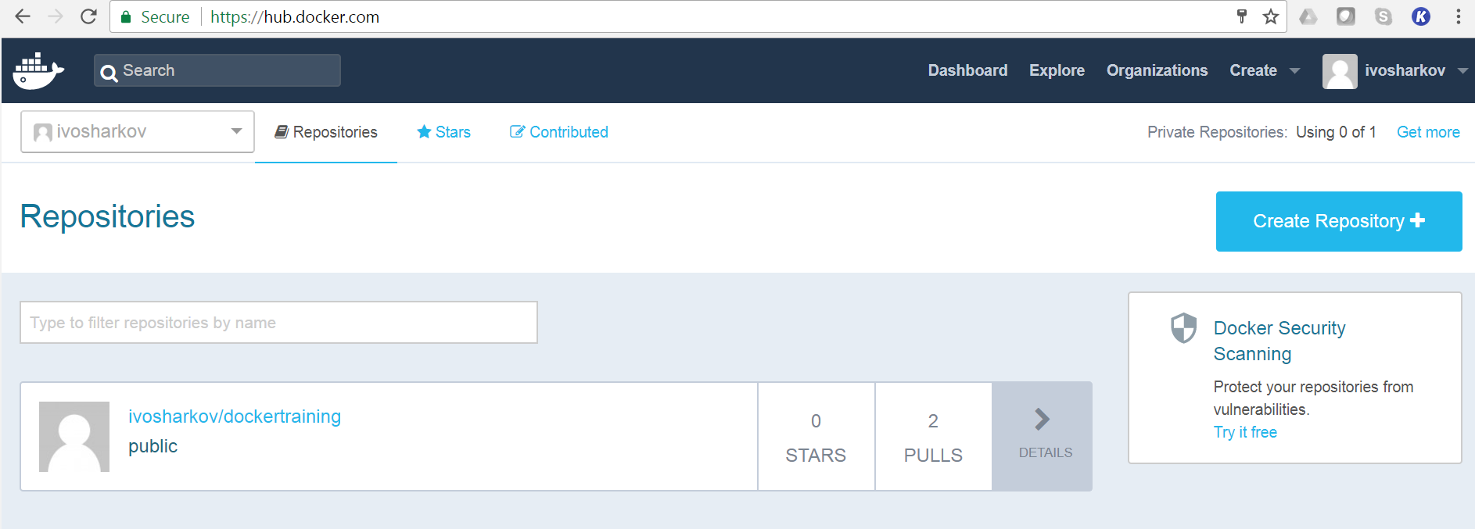
Docker Hub Repositories
Users can create their own repositories on Docker Hub
Public vs Private
Push local images to a repository

Slide 23
Pushing Images to Docker Hub
Use docker push command
Syntax: docker push repo:tag
Locla repo MUST have the same name and tag as the Docker Hub repo

Slide 24
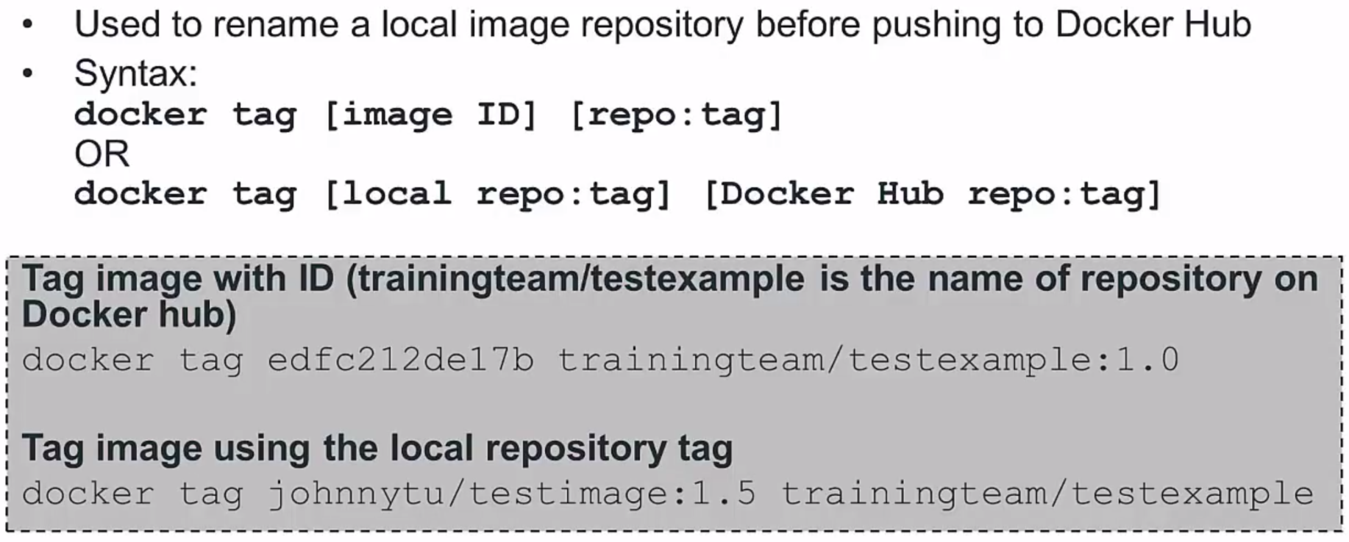
Tagging Images

Slide 25
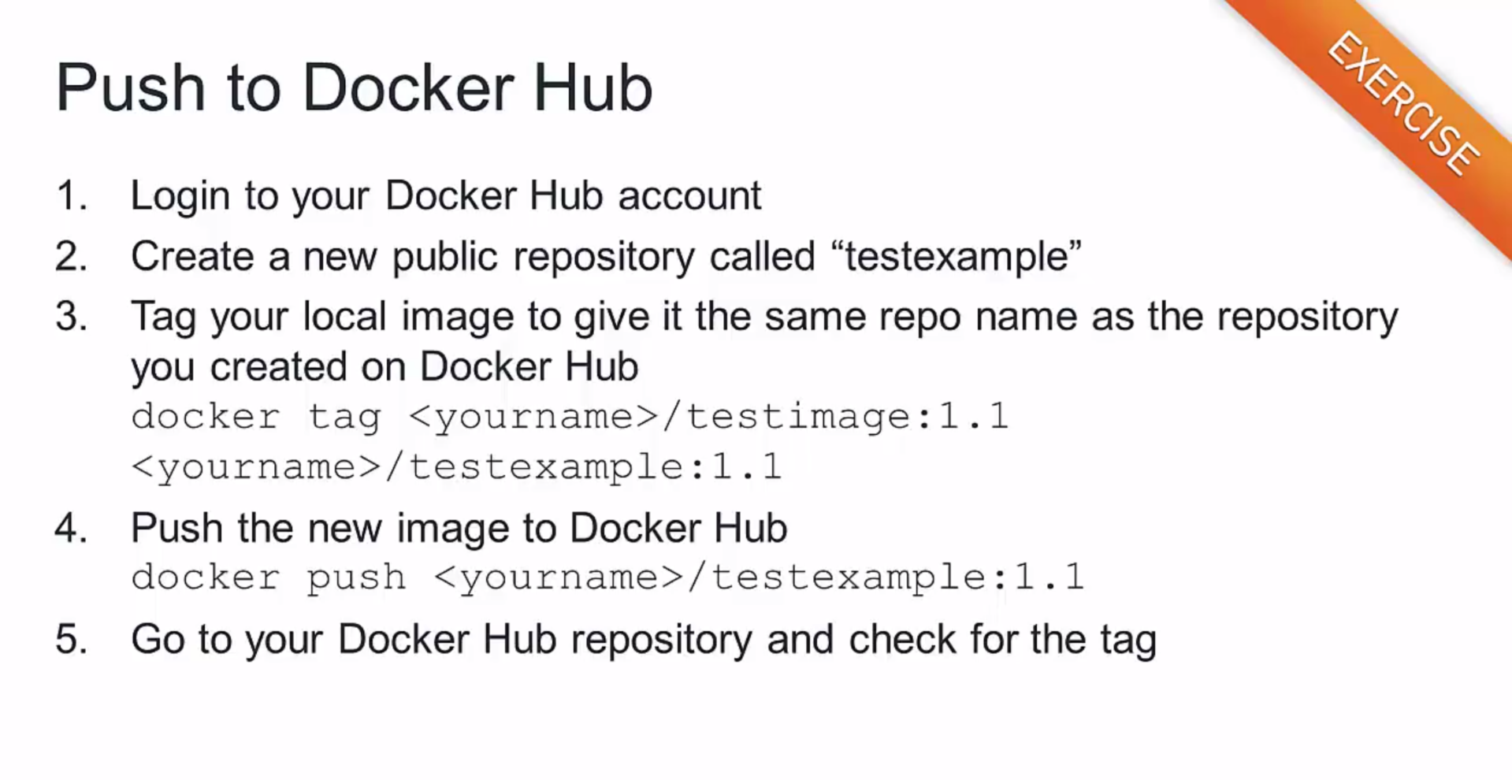

Slide 26
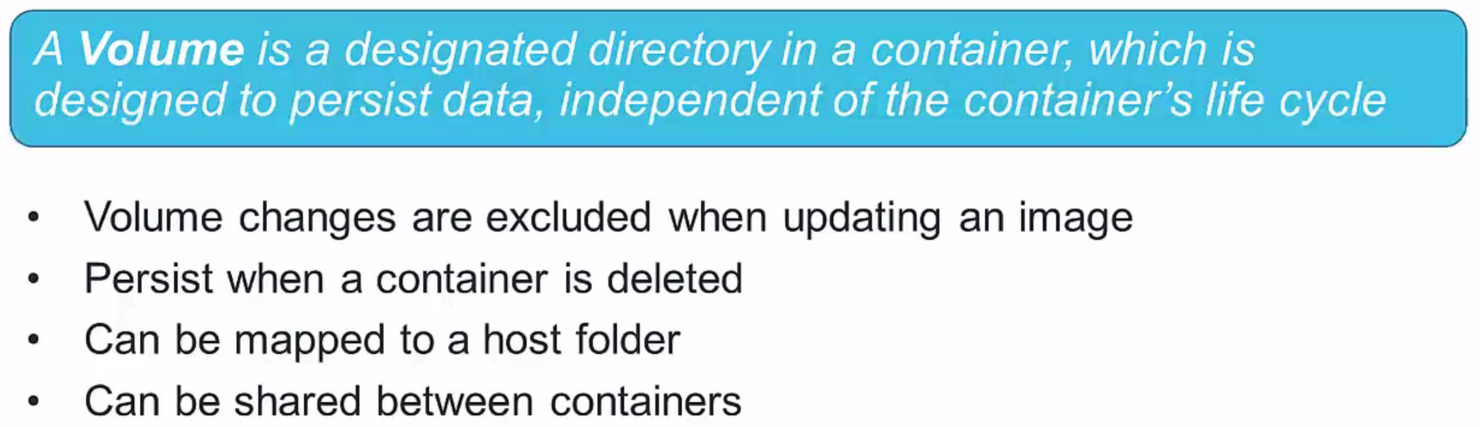
Volumes

Slide 27
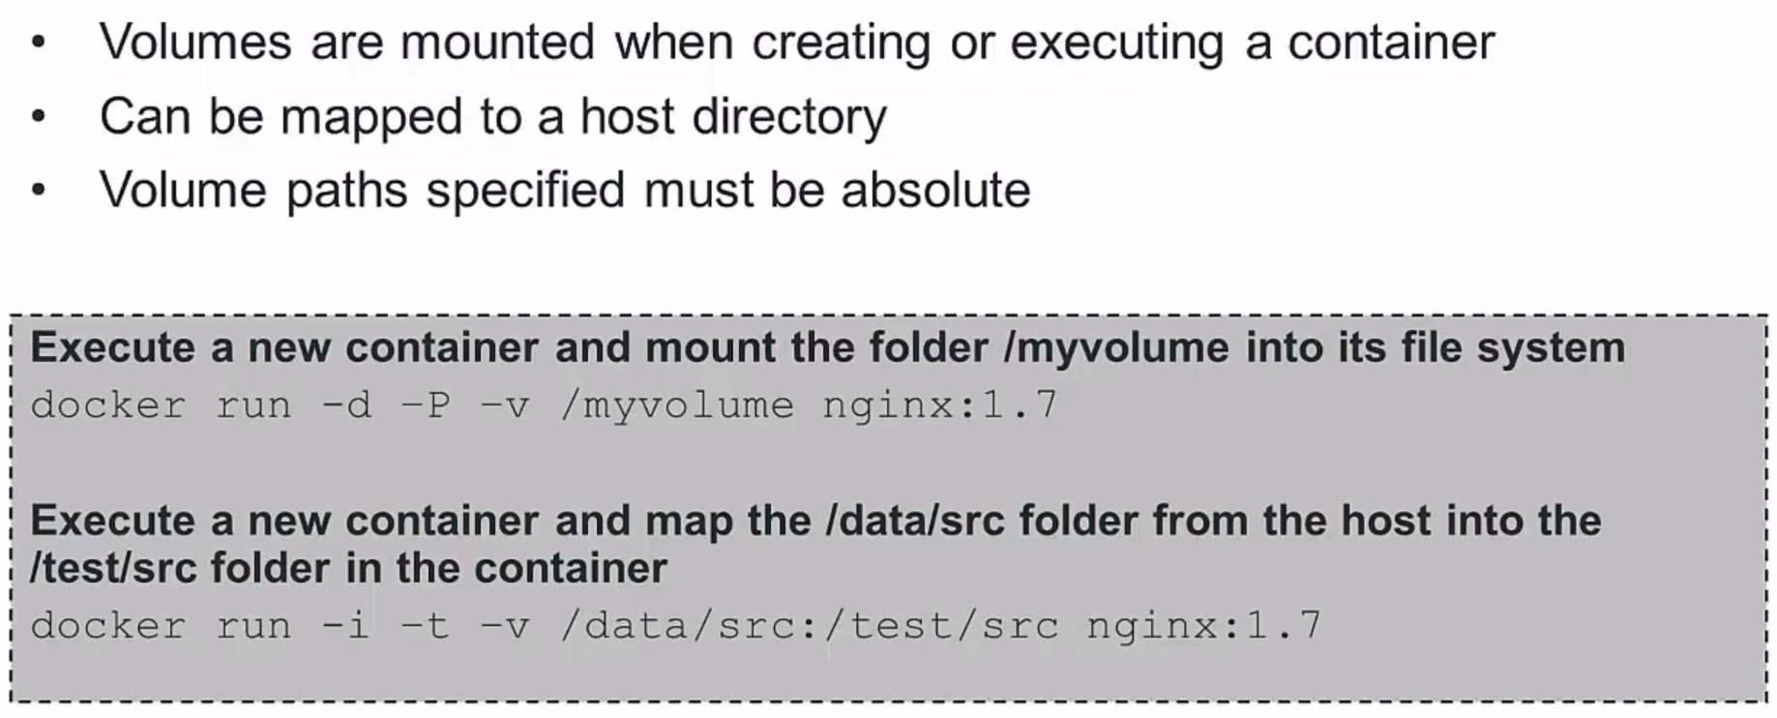
Mount a Volume

Slide 28
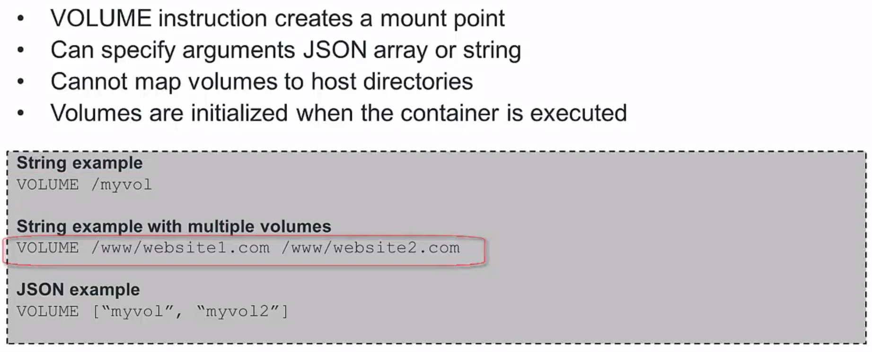
Volumes in Dockerfile

Slide 29
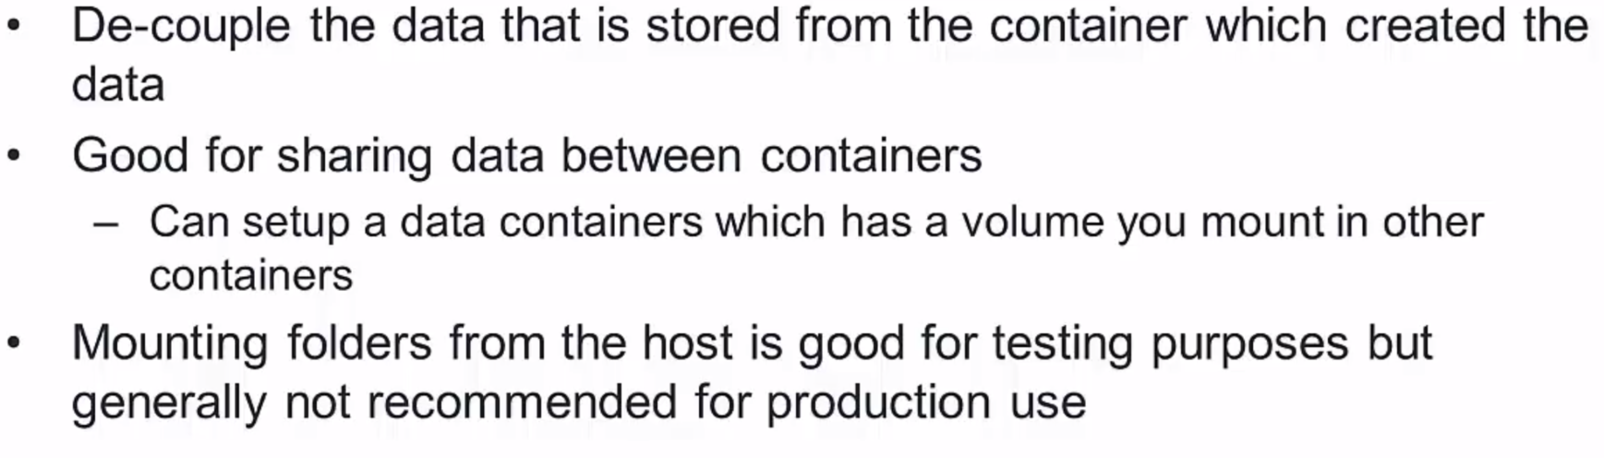
User of volumes

Slide 30
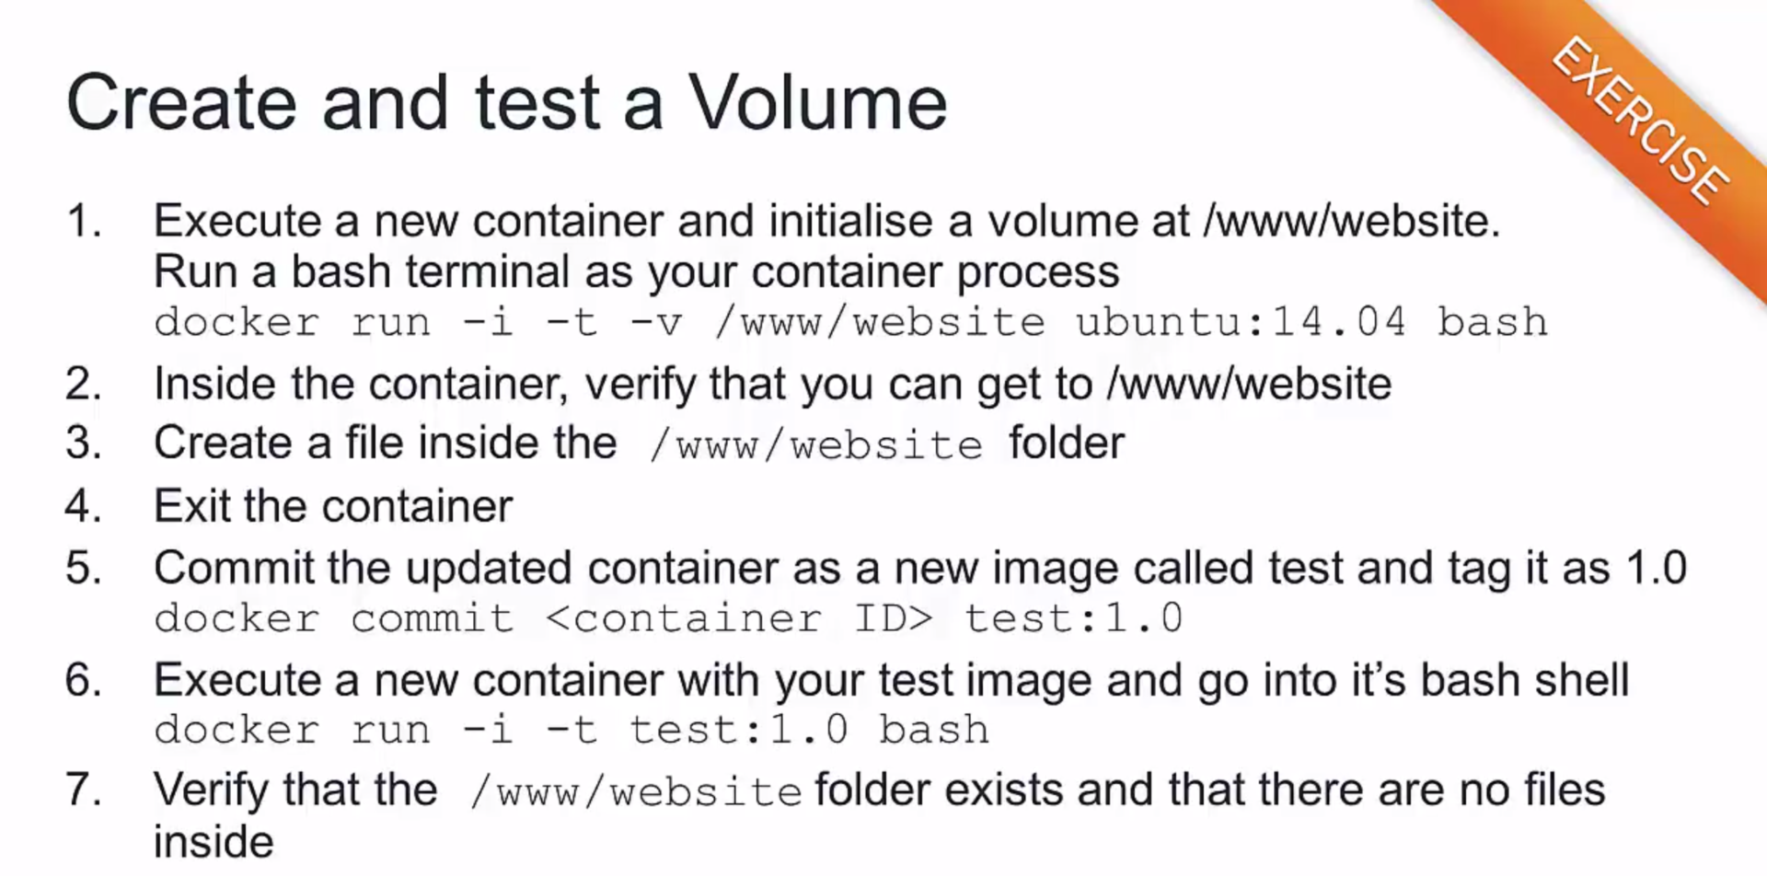

Slide 31
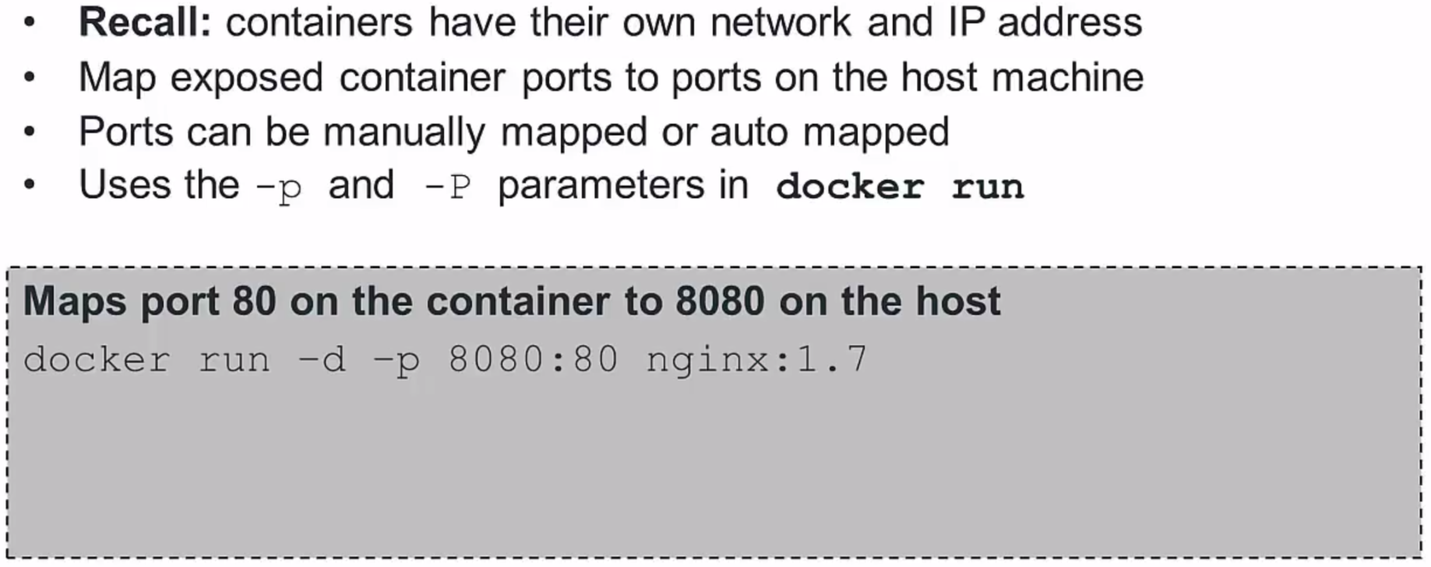
Mapping ports

Slide 32
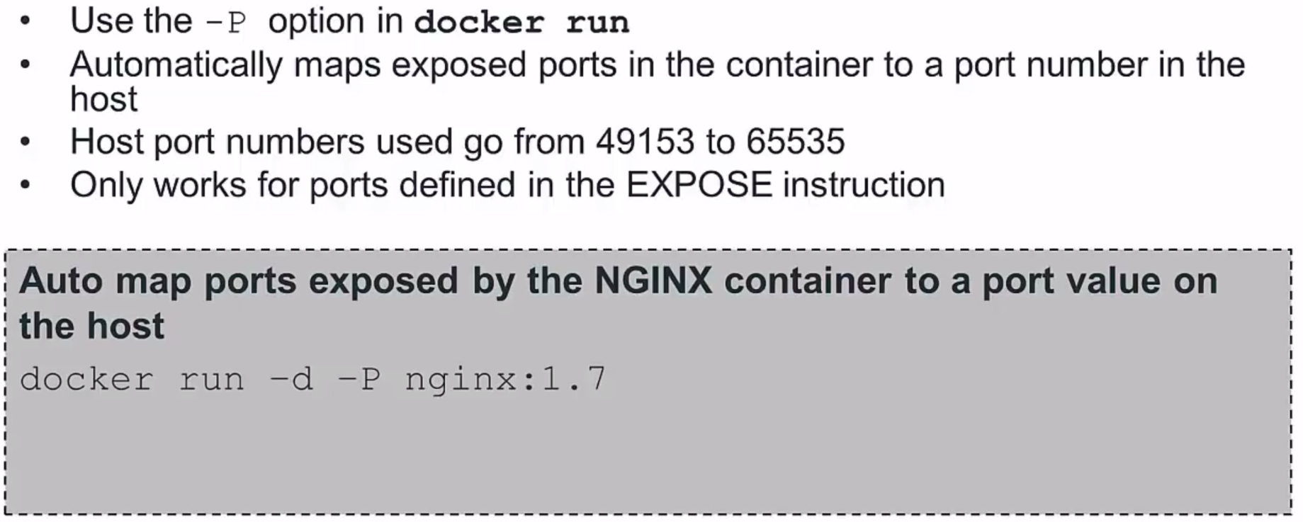
Automapping ports

Slide 33
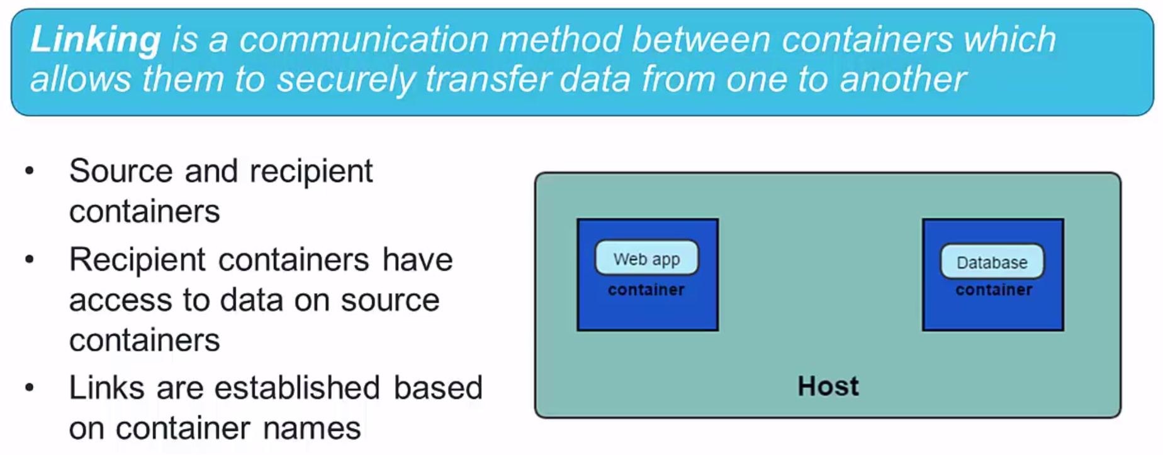
Linking Containers

Slide 34
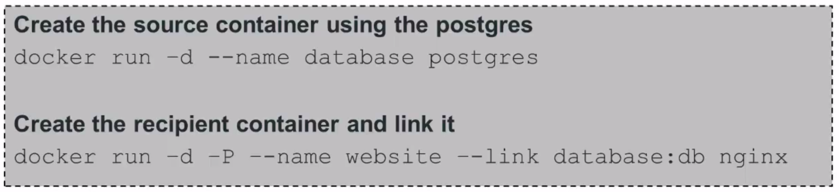
Create a Link
Create the source container first
Create the recipient container and use the --link option
Best practice – give your container meaningful names

Slide 35
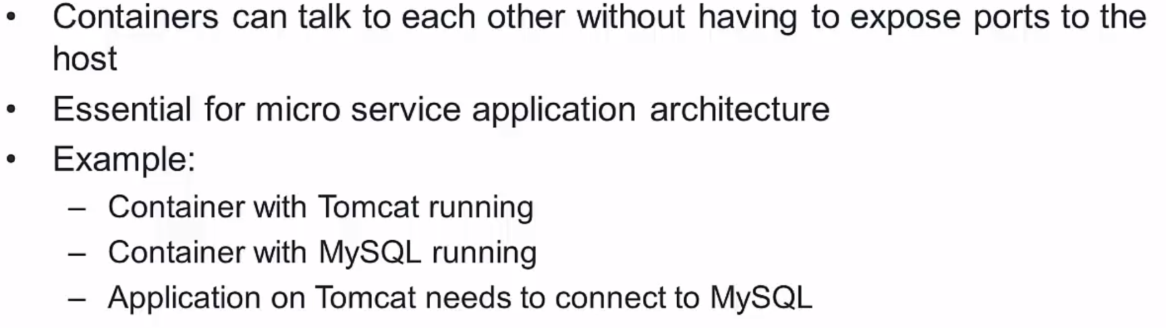
Linking Use cases

Slide 36
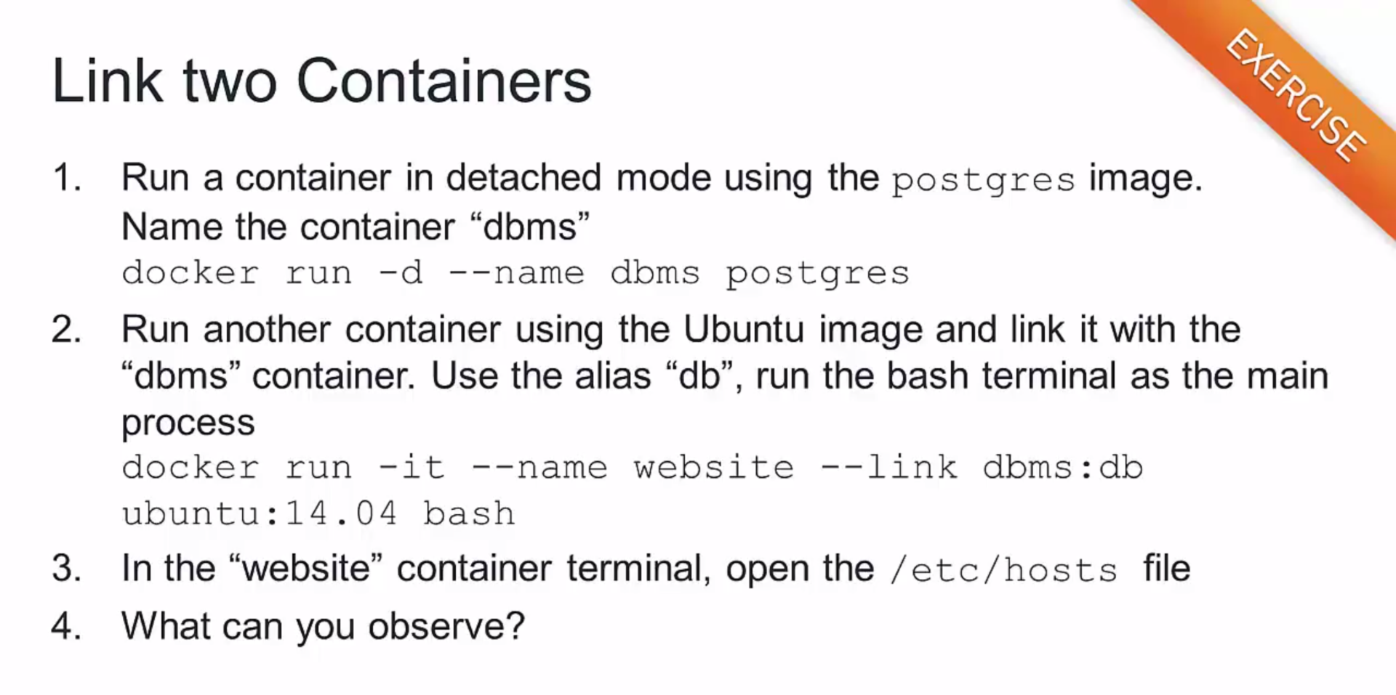

Slide 37
Make hands dirty
Start Nginx –p 555:80 and Jenkins –p 8000:8080 images with persistent volumes on the file system
Ensure you are able to login in localhost:8000 and the data will endurance docker rm –f jenkins
Modify Nginx configuration so any request to http://localhost:555/jenkins should be redirected to our Jenkins service

Slide 38


Slide 39
References
Dockerfile best practices
https://docs.docker.com/engine/userguide/eng-image/dockerfile_best-practices/
CMD vs Entry
https://www.ctl.io/developers/blog/post/dockerfile-entrypoint-vs-cmd/
Books for free
http://gen.lib.rus.ec/
Google ☺

